Slide 2

Basho Technologies
Quorums

Slide 4



2¹⁶⁰
0
Node 2
Node 1
PUT “cowboy”
2¹⁶⁰/2
Node 3
Node 4
Notes:
--

Slide 5
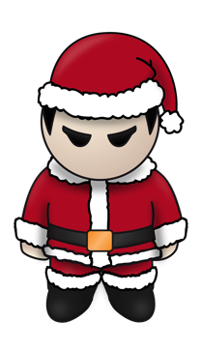
When to report success?
client
Notes:
--

Slide 7
yep!
are you done yet?
yep!
yep!
client
W=3 (all 3 acknowledge a write)
Notes:
--

Slide 8
yep!
are you done yet?
yep!
meh, good enough.
zzz…
client
W=2
Notes:
--

Slide 9
Quorum

Slide 10
R

Slide 11
W, DW

Slide 12
PR, PW

Slide 13

Notes:
--

Slide 14

here
right this
way sir
Notes:
--

Slide 15
here
right this
way sir
hang here
for a bit.
Notes:
--

Slide 16
here
right this
way sir
not gonna happen!
Notes:
--

Slide 17
Read/Write Quorums
Acknowledge (R, W)
Ack + Write to Backend (DW)
Primary-only (PR, PW)

Slide 18
Quorums

